Slide 1
Smartsheet Training
Office for Continuous Professional Learning (CPL)

Slide 2
Five (5) Smartsheet forms were shared with you after your application was approved for CME credits.
1.) Attendance Dashboard
2.) Report for Coordinator
3.) Disclosure Sheet
4.) Upload Sheet
5.) Disclosure Sheet

Slide 3
Attendance Dashboard *Calculates the number of attendees and breaks it down into MD/DO and other Learners. *Shows how many activities have taken place this accreditation year. *You can also access your other shared sheets from this sheet. *Shows how many hours of CME credit is being awarded per activity.

Slide 4
Step 1: Upload Form We provided you with a unique link to an Upload Form for your program. PDF copies of your weekly announcements, evaluation summaries and other required documents can be uploaded here.
Two Weeks Prior :
Announcements and disclosures are to be uploaded into Smartsheet at least two weeks prior to the activity.
This allows us to resolve any possible Conflict of Interest (COI) issues and to review any slides for those speakers with listed COI's.
Credit will not be awarded (a) for an activity when disclosures are not received prior to activity and (b) where disclosure is not announced to the audience
ACCME requires that these two conditions be met for an activity where attendees receive CME credit: Going forward, all disclosures must be received prior to the activity and are to be disclosed to the audience on your announcement template or on your intro slides. ACCME further mandates if you do not have a disclosure prior to the activity, the speaker must be recused or no credit will be awarded for that activity. We must follow these requirements. Disclosures must be in Smartsheet prior to the activity; otherwise, credit will not be awarded for that day.

Slide 5
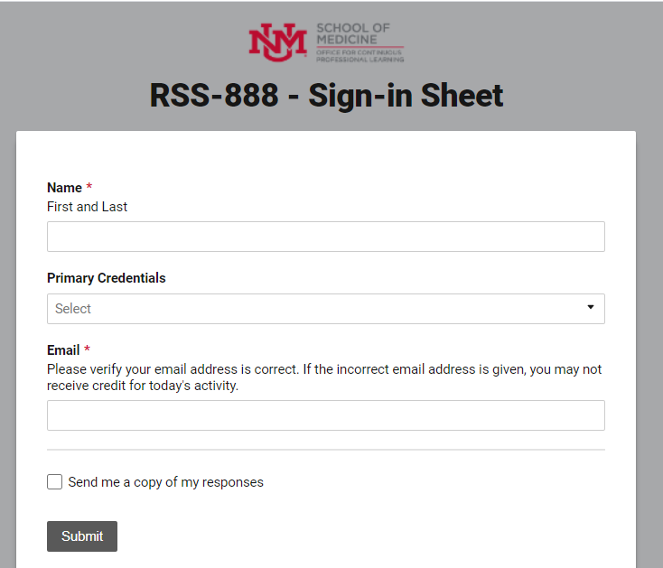
Sign in Sheet

Slide 6
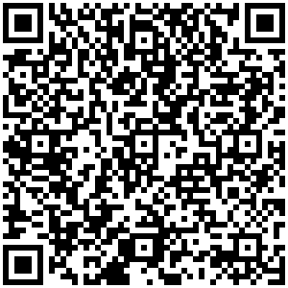
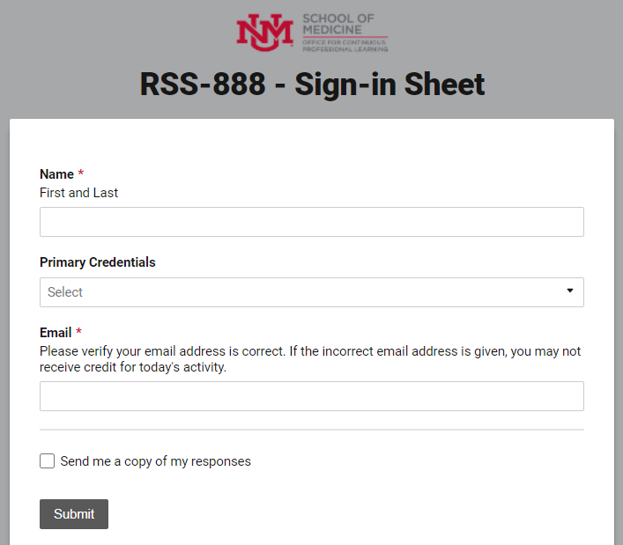
QR Code
Each program will be provided with a QR Code, which directs them to their special Sign-in Form.
Print several and post near registration desk and on door to event.
Attendees can use phone to scan the code and enter their name and email into the sign-in form.
Cache on phone saves this information, so it brings it up the second time it is used.

Slide 7
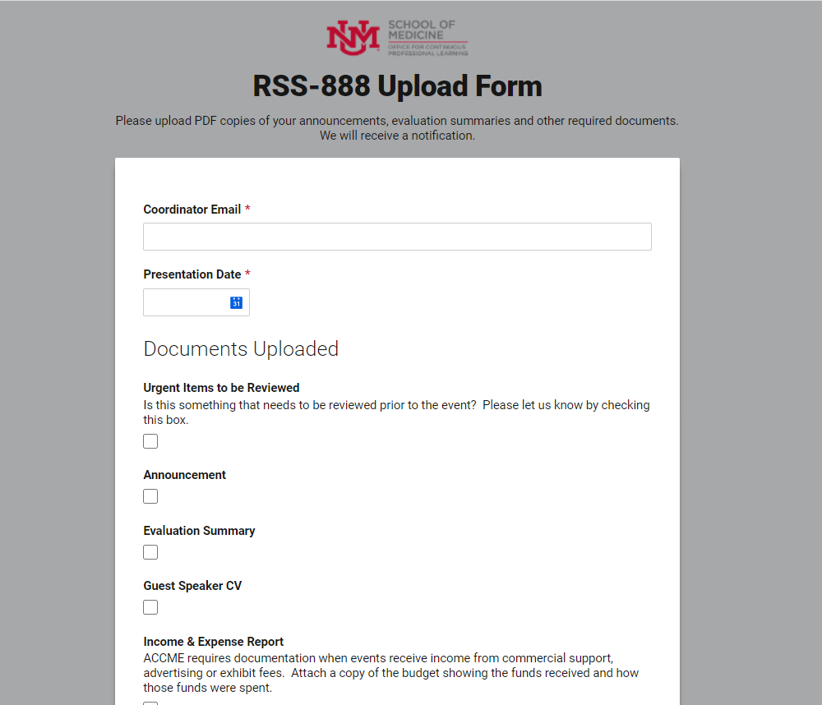
Step 1 Upload Form
Two Weeks Prior
Announcements and disclosures are to be uploaded into Smartsheet at least two weeks
prior to the activity.
This allows us to resolve any possible Conflict of Interest (COI) issues and to review any slides for those speakers with listed COI's.
We will provide you with a unique link to an Upload Form for your program. PDF copies of your weekly announcements, evaluation summaries and other required documents can be uploaded here.

Slide 8
Step 2 Attendees sign-in. (Entries are approved 15 min. prior, during the activity and 15 min. after the closing of the activity.)

Slide 9
Edit Four (4) Yellow Columns within 24 hours of activity.
Activity Name: Speaker’s Presentation Title
Activity Date: Actual Date of Activity
Speaker: Click it if the person was a speaker at this activity.
Partial Credit: Only enter if someone did not attend the entire activity.
Step 3
Coordinator’s Report

Slide 10
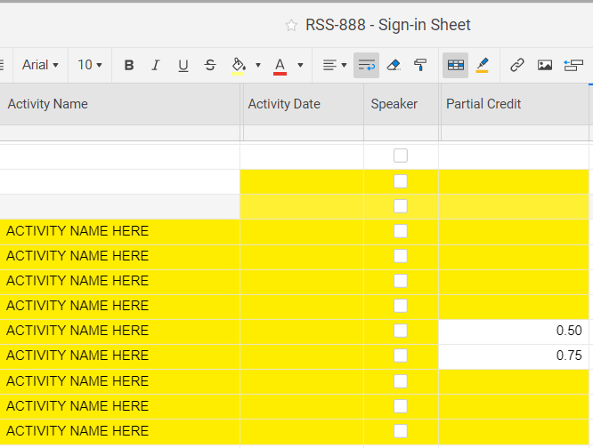
Copying Cells
Enter the speakers presentation title in the first yellow cell of “Activity Name” Column.
Then grab the bottom right point of the cell and drag it down. It will copy it for you, so no need to retype it each time.
Partial Credit
Only add information into this column when someone attends less than the entire activity.

Slide 11
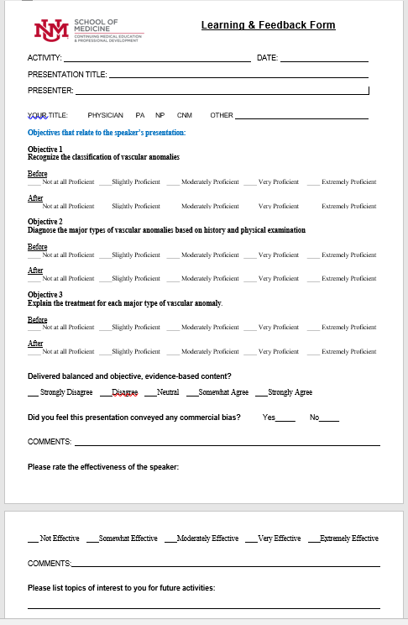
Step 4 Learning & Feedback Form and Evaluation Summary
ACCME's expectation is that accredited providers evaluate the impact of their activities on learners’ knowledge, strategies/skills, performance, and/or patient outcomes (Analyzes Change).
Every program is required to evaluate their program, as well as assess the learning of their attendee’s. We have several Learning & Feedback Form templates to choose form.
Every program is required to provide an Evaluation Summary twice a year for the periods of January – June and July – December.
The Evaluation Summary is an overall summary of the responses from your Learning & Feedback Forms. The responses are averaged for the entire time period, and it would also include all of the comments for this time period, as well.

Slide 12
ACCME Requires Speaker Disclosures prior to the activity. Please note: Disclosures must be in Smartsheet prior to the activity; otherwise, credit will not be awarded for that day.
Credit will not be awarded (a) for an activity when disclosures are not received prior to activity and (b) where disclosure is not announced to the audience.
ACCME requires that these two conditions be met for an activity where attendees receive CME credit: Going forward, all disclosures must be received prior to the activity and are to be disclosed to the audience on your announcement template or on your intro slides.
ACCME further mandates if you do not have a disclosure prior to the activity, the speaker must be recused or no credit will be awarded for that activity. We must follow these requirements. Disclosures must be in Smartsheet prior to the activity; otherwise, credit will not be awarded for that day.

Slide 13
Transcript’s
Email our office at HSC-CPL@salud.unm.edu
SUBJECT LINE: Transcript Needed for “Name”
@

Slide 14
Regularly Scheduled Series (RSS) Team
Operation’s Specialist, Kathy Breckenridge
272-6707, Kbreckenridge@salud.unm.edu
Administrative Assistant III, Jennifer Harbaugh
272-3942, Jharbaugh@salud.unm.edu
Grand Round Assistant, Alexandra (Alex) Hurst
272-3942, HSC-CPL@salud.unm.edu
General Email: HSC-CPL@salud.unm.edu

